Slide 1
O&M V3
Kathi Schleidt
HDWG Spring 2023

Slide 2
O&M V3 Modification Overview
Drivers
Comments (Both OGC and ISO)
Requirements from
External initiatives (e.g. INSPIRE)
Other OGC Models (e.g. Coverage)
Alignment with SOSA/SSN from W3C/OGC
Developments towards
APIs
Linked Data
Modifications
3 Tier Model
Additional Concepts
Fine-grained Requirements Structure

Slide 3
3 Tier Model
Conceptual Model: Interface level O&M → allows for abstraction towards other data models
Abstract Core: Abstract classes for all concepts → starting point for development of domain models
Basic: simple concrete classes for all concepts → allows for simple out-of-the-box uptake
Structure created for both parts of O&M Model:
Observation
Sample

Slide 4
3 Tier Model - Observation

Slide 5
3 Tier Model - Sampling

Slide 6
Additional Concepts - Observation
Observer – abstracted from SOSA Sensor
Host – abstracted from SOSA Platform
Deployment – link between Observer and Host
relatedObservation association ubiquitous across model

Slide 7
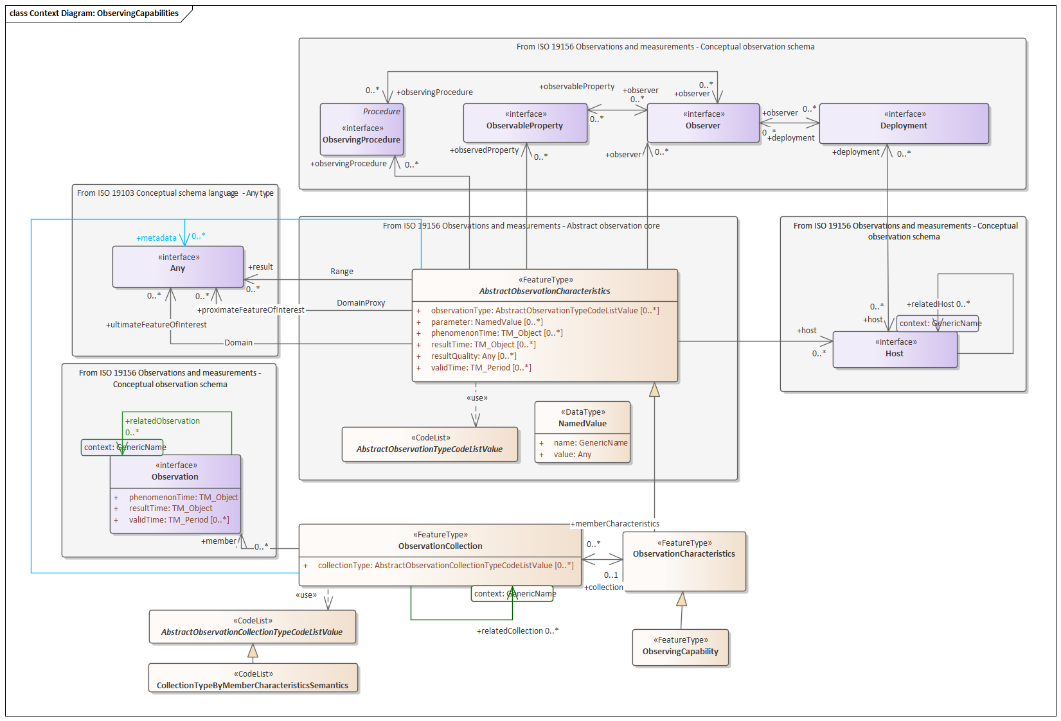
Additional Concepts - Observation
Homogenous
property not provided: values may be provided by the observations but is not provided at this level
property provided but with no content: no observation within the collection provides this property
property = value: this value applies to all observations within the collection
property = value set/range: this value set/range applies to all observations within the collection
Summarizing
property not provided: values may be provided by the observations but is not provided at this level
property provided but with no content: no observation within the collection provides this property
property = value: this value applies to all observations within the collection
property = value set/range: all observations provide a value within this set/range
Observation Characteristics:
Basic characteristics of Observations
Used to derive Observation and ObservingCapability (new potential Observation)
Defines ObservationCollection (also new)
FeatureOfInterest is differentiated into:
proximateFeatureOfInterest
ultimateFeatureOfInterest

Slide 8
Additional Concepts - Sample
Sampling: from SOSA, act of taking a Sample
Sampler: from SOSA, person or device that performs the Sampling
Procedures: derived from Observation:Procedure, specialized as:
SamplingProcedure: Procedure performed by the Sampler during Sampling
PreparationProcedure: Procedure performed during a PreparationStep
Relations:
relatedObservation: association from Sample to related Observation
relatedSample: association from Sample to related Sample
relatedSampling: association from Sampling to related Sampling
Sample Types:
SpatialSample: was SF_SpatialSamplingFeature (dropped point, curve, surface, solid)
MaterialSample: was Specimen
StatisticalSample: introduced for statistical stratifications

Slide 9
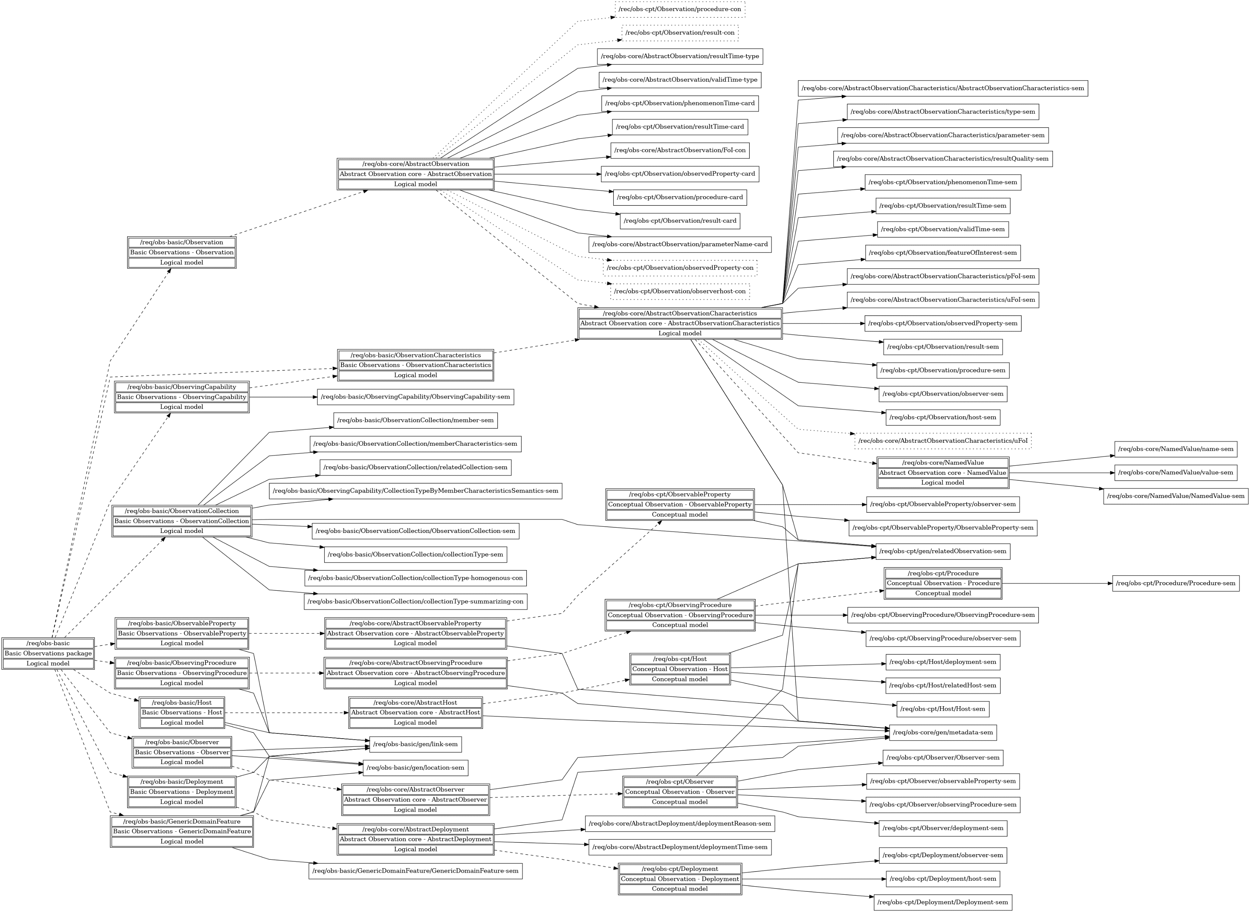
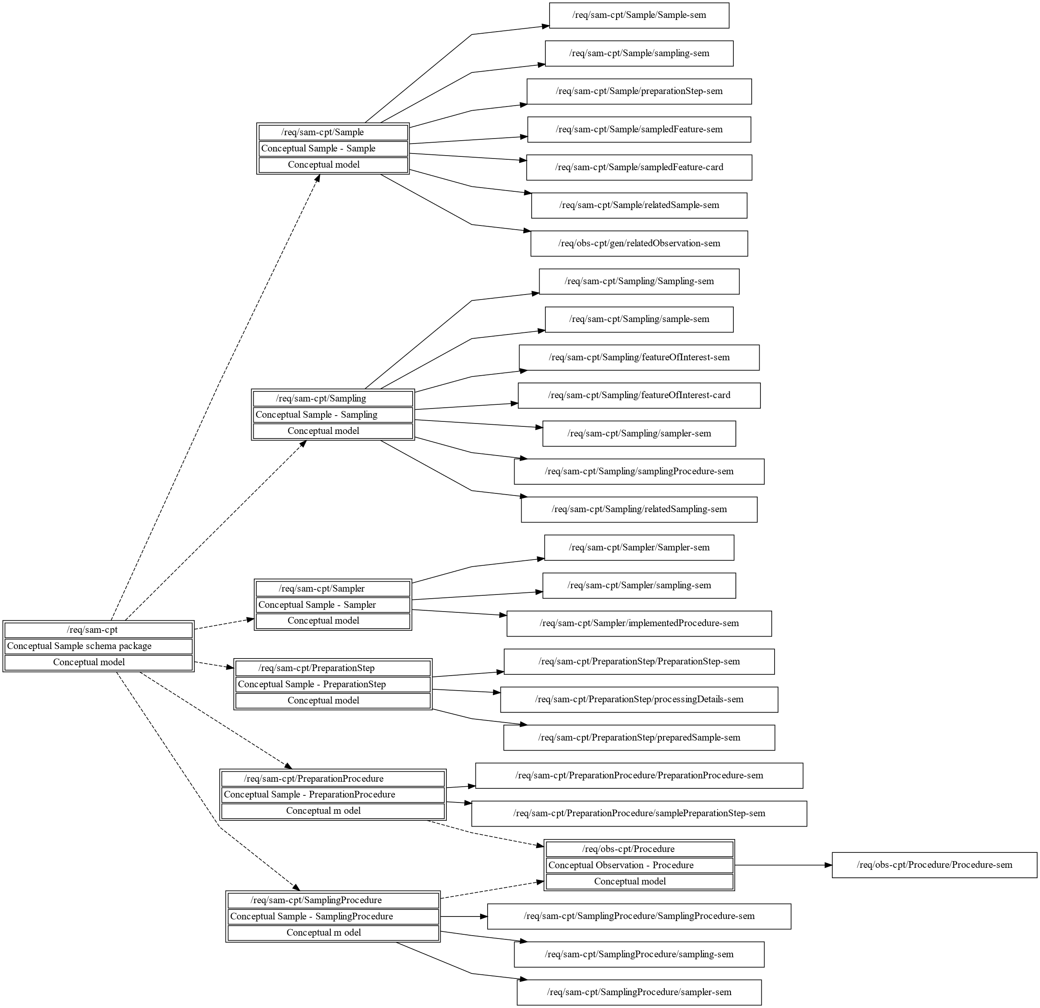
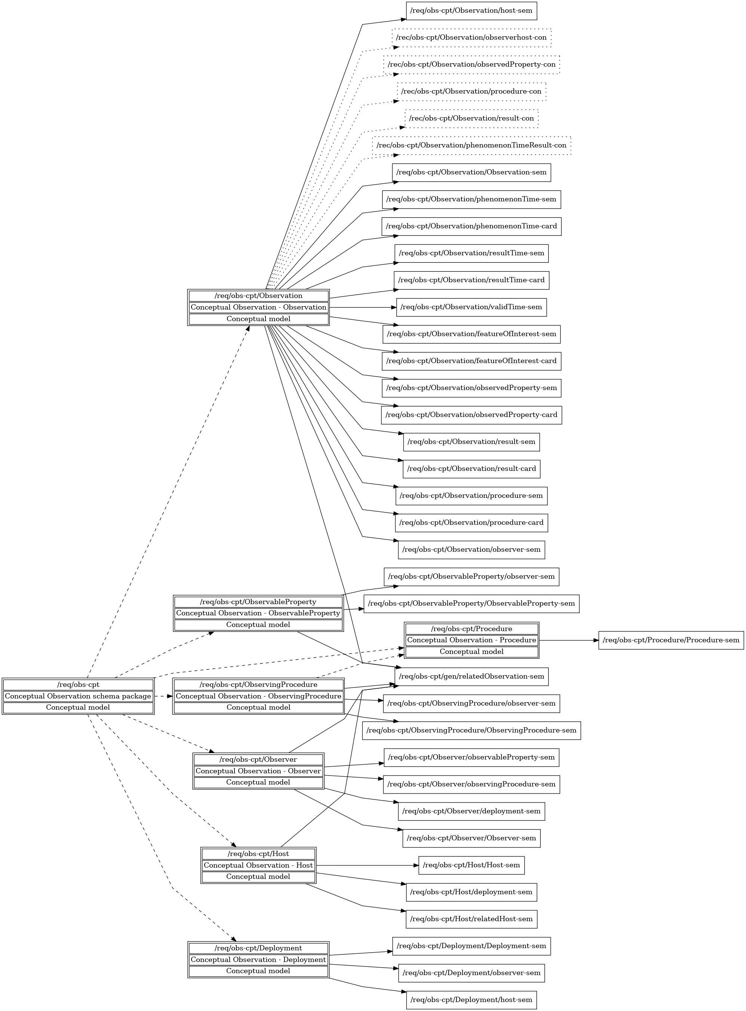
Requirements Structure
Very fine-grained URI based model
Base URI per package
Requirements name syntax:
{Class Name}-sem: Semantic definition of concept with Class name
{Attribute/Association Name}-sem: Semantic definition of concept with name of attribute or association role. In most cases open cardinality, so 0..*;
{Attribute/Association Name}-type: Type information where constrained within one model package;
{Attribute/Association Name}-card: Cardinality information pertaining to the attribute or association;
{Attribute/Association Name}-con: Additional constraints. As sometimes pertain to multiple attributes/associations, naming may become more complex.
Requirements classes include both requirements and further requirements classes
Suitable for API conformance declaration
Conformance Classed defined for all Requirements Classes
But – we’ve broken the rule on 1:1 alignment between Conformance Classes and Packages!

Slide 10
Next Steps
JSON Encoding
GeoJSON or JSON-LD or GeoJSON-LD?
Input from/to new OGC Features and Geometries JSON SWG
First attempt utilizing STA
Semantic Version
Updating SOSA/SSN to align with OMS

Slide 11
Ad-Hoc STA^{OMS}
OData approach behind STA seems well suited O&M data graph (in V2 or V3)
FROST Implementation has been abstracted to support alternative or extended data models
Add further classes to STA Model
Use a totally different data model, e.g. O&M V3
Still trying to see how OMS fits into the brave new OGC API world
Simple query modalities currently available don’t meet requirements
Don’t have the time to wait until it does
https://ogc-demo.k8s.ilt-dmz.iosb.fraunhofer.de/FROST-OMS/v1.1/

Slide 12
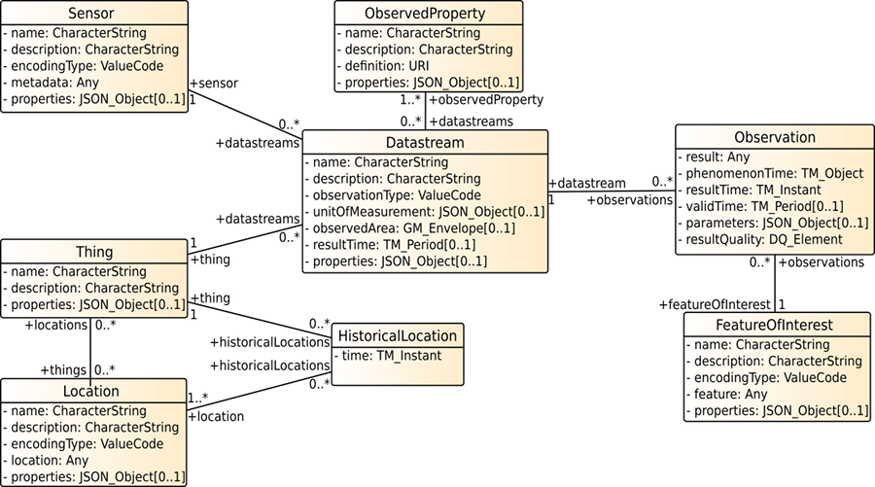
Data Model Comparison
STA Data Model

Slide 13
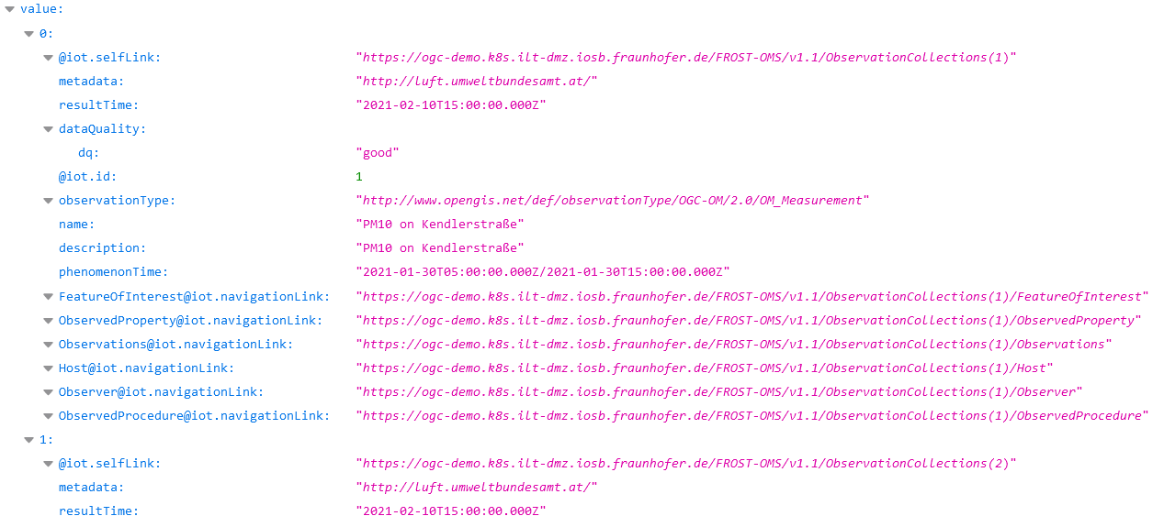
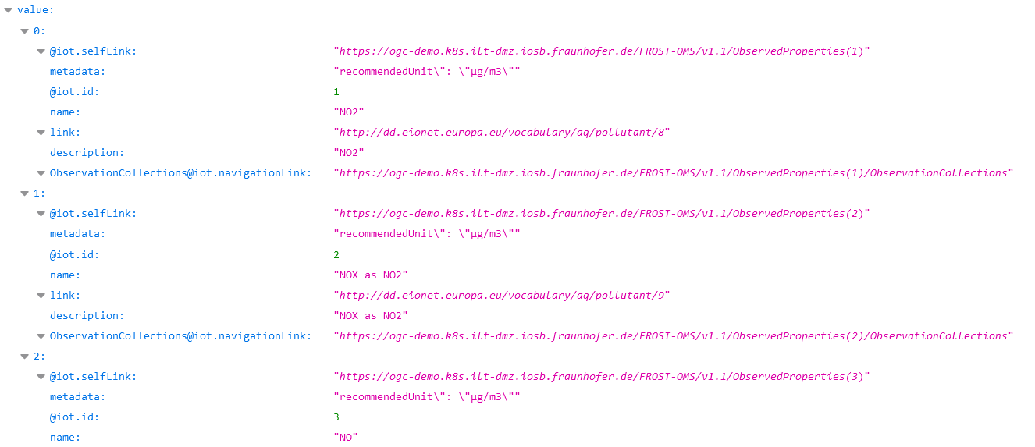
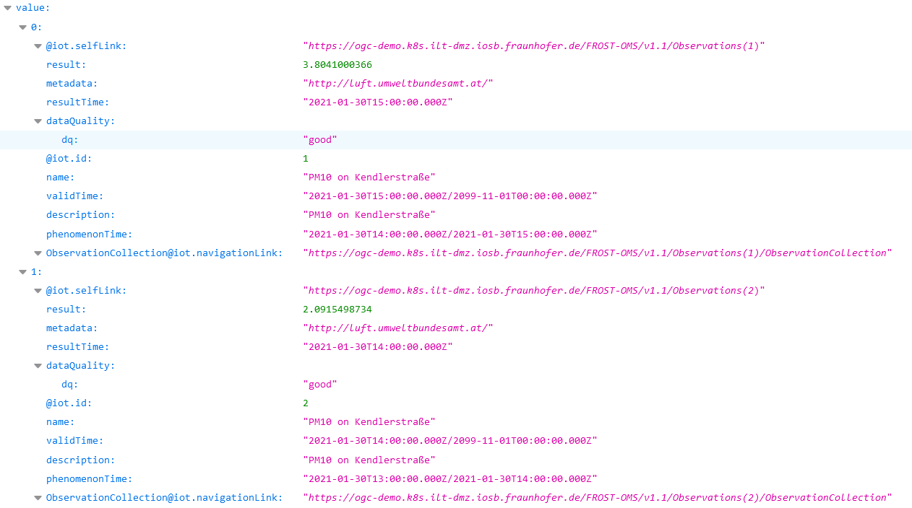
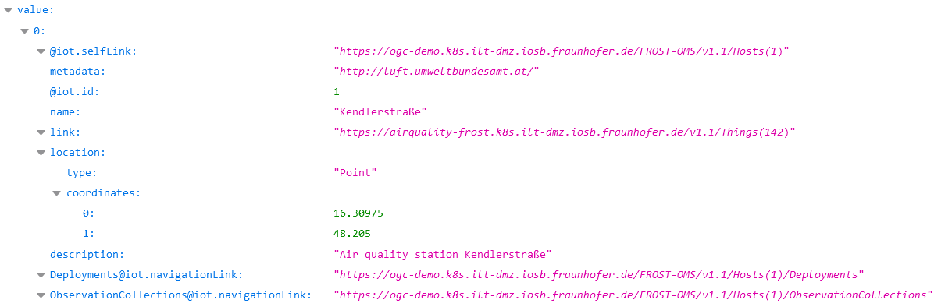
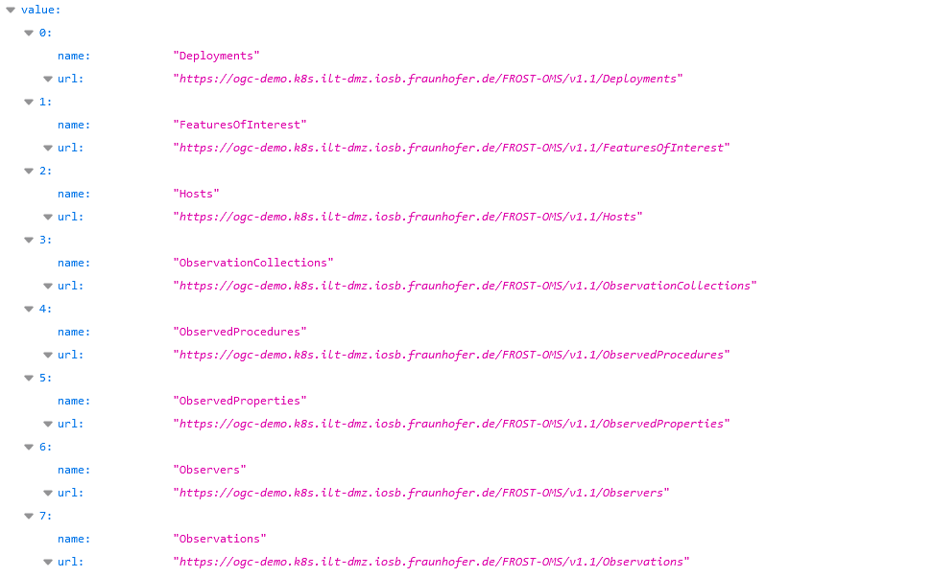
First Prototype
ObservedProperties
Hosts
Observations
https://ogc-demo.k8s.ilt-dmz.iosb.fraunhofer.de/FROST-OMS/v1.1/
ObservationCollections

Slide 14
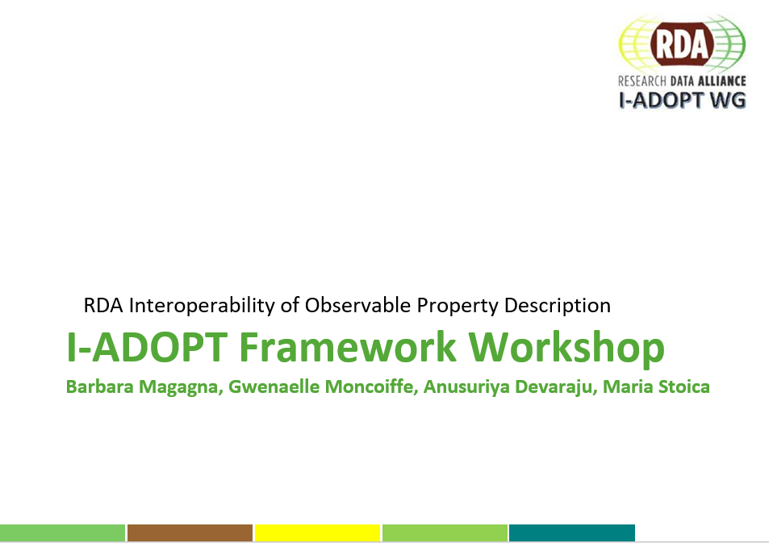
I-ADOPT Framework
Goal: creation of a model for complex Observable Properties
Motivation: Addressing the “I” of FAIR Data Management
By building a conceptual framework to support interoperability between existing terminologies and address a broad range of known user requirements
By promoting the use of FAIR terminologies to annotate research data with well identified, unambiguous and machine readable vocabularies
I-ADOPT chairs: Barbara Magagna, Gwenaelle Moncoiffe, Maria Stoica, Anusuriya Devaraju

Slide 15
Conceptualizations for observable properties
Monthly mean dissolved lead (ppb) in water taken from the river Thames by sampling
Monitored
Property
Monthly mean dissolved lead (ppb) in water
Observable
Property
River Thames
Sampling
Feature
Process
🡪 ontology, conceptual model

Slide 16
Controlled vocabularies for parts of ObsProps
Monthly mean dissolved lead (ppb) in water taken from the river Thames by sampling
Monitored
Property
River Thames
Monthly mean dissolved lead (ppb) in water
Observable
Property
Sampling
Feature
Process
monthly mean
dissolved
lead
concentration
water
ppb
controlled list 1
controlled list 2
CHEBI
QUDT quantities
QUDT units
EnvThes

Slide 17
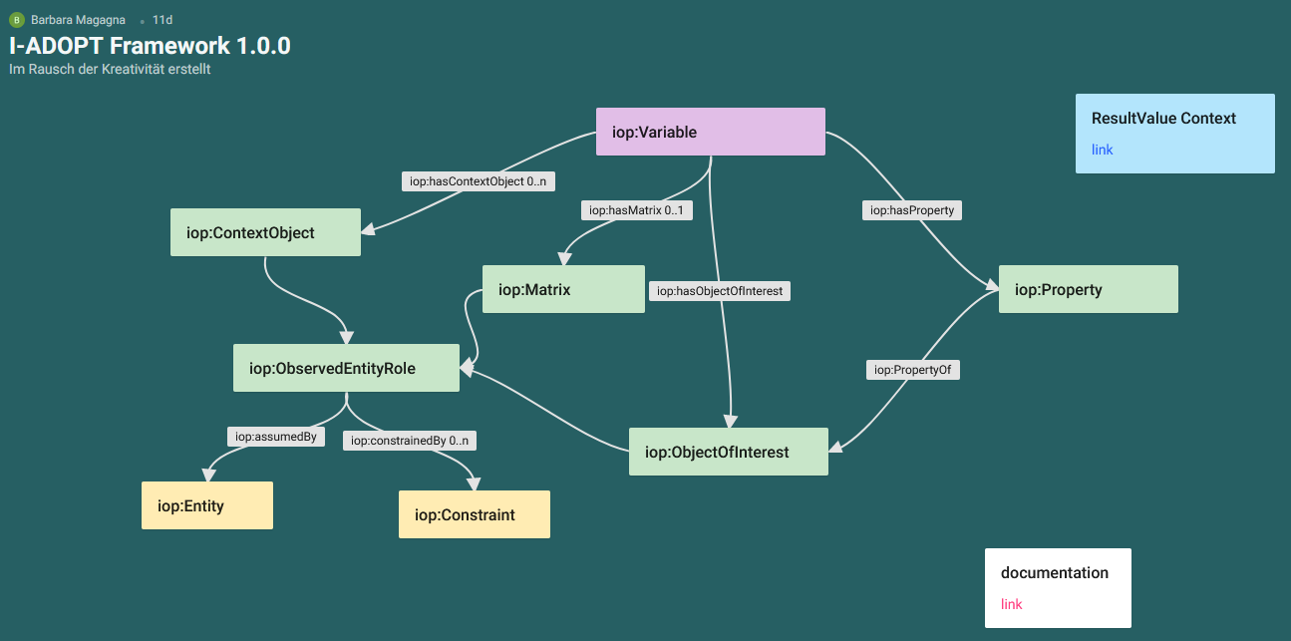
I-ADOPT Framework
https://padlet.com/barbaramagagna/sogprgszse1bgd24

Slide 18
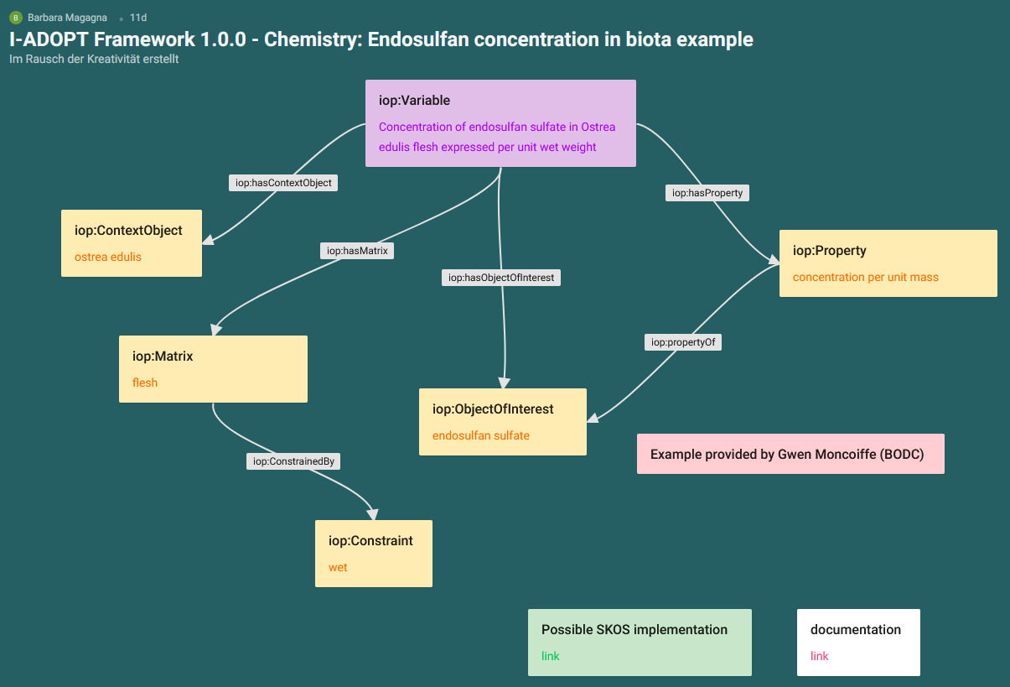
Chemistry example: Endosulfan

Slide 19
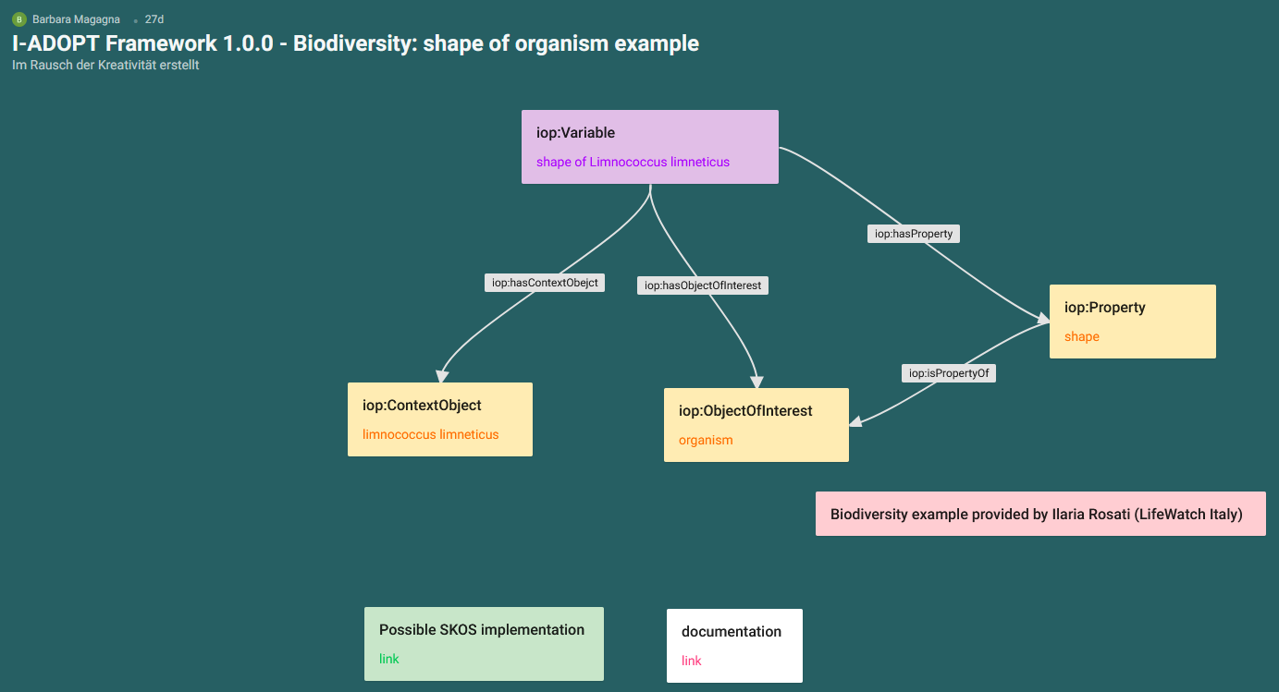
Biodiversity example: Shape of organism

Slide 20
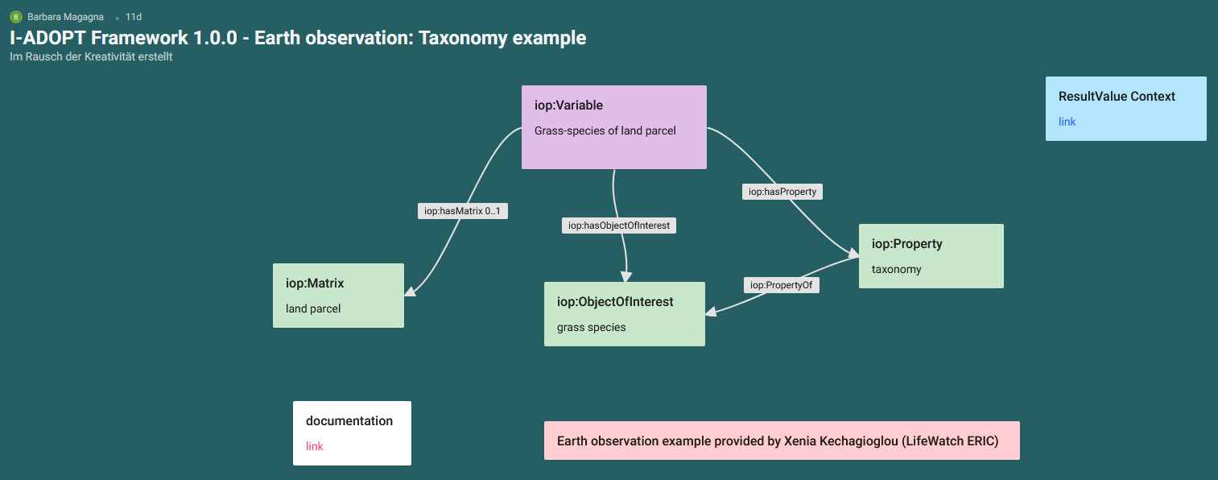
Earth observation example: Taxonomy of grass

Slide 21
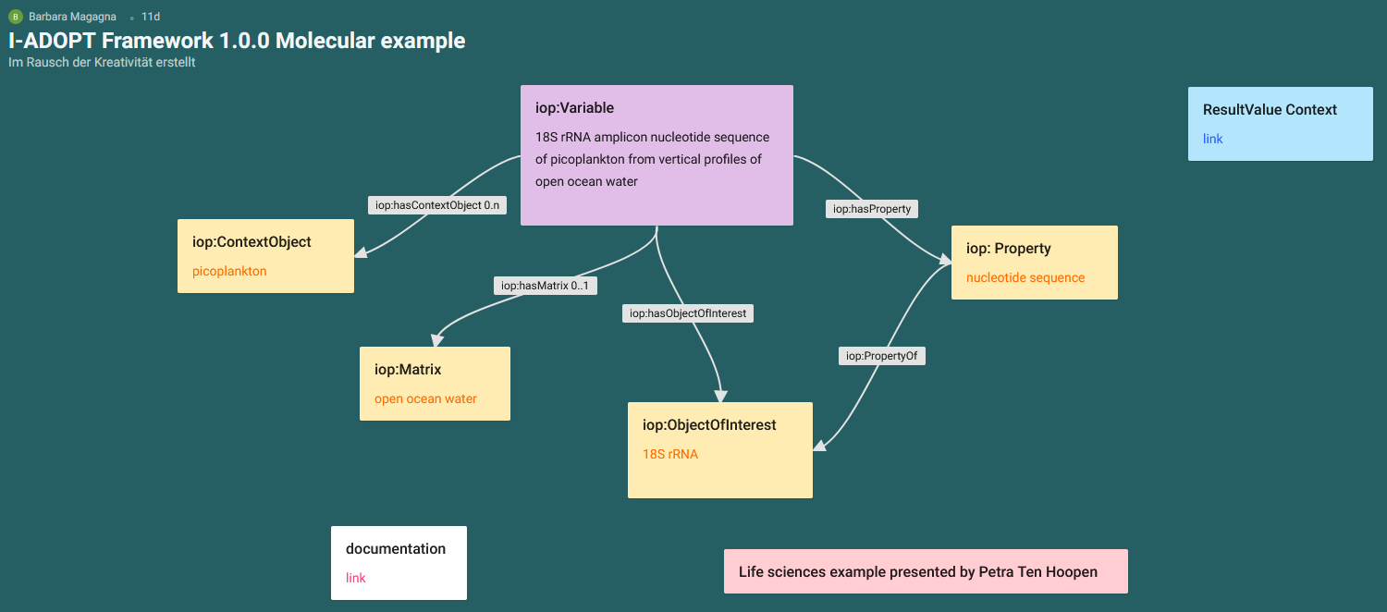
Life science example: Molecular

Slide 22
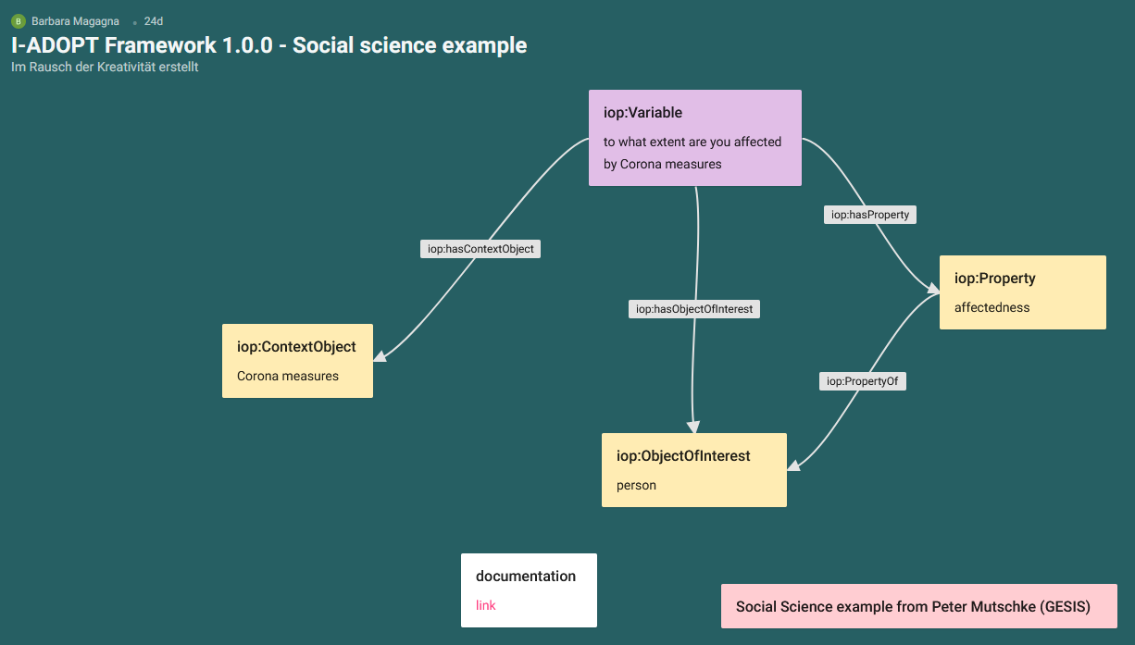
Social sciences example: Survey question

